Slide 1
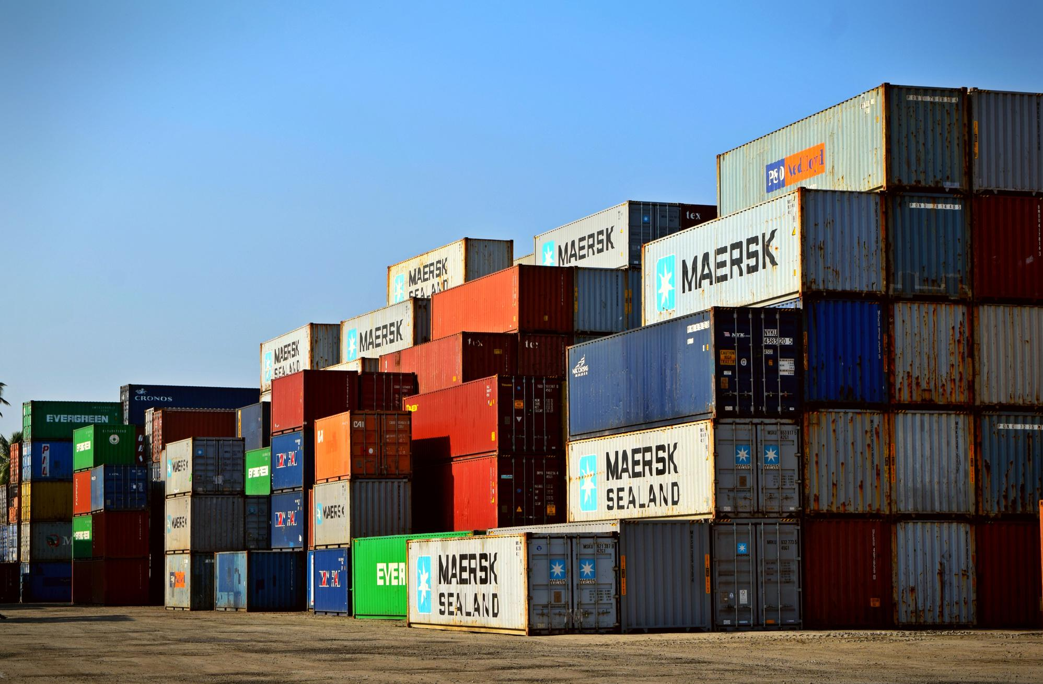
Yard Management Optimization using AI

Slide 2


Problem Statement
Efficient Container Placement System (ECPS)
Theme: Logistic Tech

Slide 3

Target Audience
Logistics companies
Distribution centers
Transportation hubs
Yard managers

Slide 4

Purpose of Project
Our project tries to address the challenge of optimizing the container placement within yards to minimize the re-shuffling of containers and save cost and time using AI based algorithms.

Slide 5


Basic Features
Sort containers by size and type so that same type and size containers are kept together in rows and bays. | Ensuring need of shuffling to be minimum based on the gate out time and predicted leave time. | Predicting the leave time i.e., time when each container will be ready to leave the yard based on past information using AI based algorithms.
Output a 3D matrix implementing smart container placement as per the previously discussed features. | Keeping Data Safe by collecting only the necessary data for prediction and use it responsibly. | An easy to use UI for the ease of usage of this system.

Slide 6


Technologies to be used
Here are the technologies which we will be using to build the solution.
  Python: For prediction of leave time using AI based algorithms
  C++: For algorithms to implement smart container placement.
  Javascript: For easy to use UI

Slide 7
Team Members
Jayant Kumar Dubey
Prixit Singh
Aditi Kulkarni
Supriy Rathi
(Team Lead)

Slide 8


Thank you!

